Slide 1




Angelina -202401100300041
Aditya Shivhare - 202401100300018
Anish Chaudhary- 202401100300046 Abhishek Kumar - 202401100300007
Amarjeet Yadav- 202401100300033
Submitted by - Group -14
Submitted to: Bikki Sir

Slide 2
Diabetes Prediction

Slide 3
3
INDEX
Problem Statement
Introduction
Methodology
Output/Result (performance metrics)
References

Slide 4
PROBLEM STATEMENT
4
To predict whether a person is likely to have diabetes based on various medical features using machine learning techniques.

Slide 5

INTRODUCTION
Diabetes is one of the most prevalent chronic diseases in the world, affecting millions globally. Early prediction can lead to better treatment and management. This project aims to predict diabetes using a supervised machine learning classification model trained on a medical dataset.
Dataset Used: The Pima Indians Diabetes Database from Kaggle/UCI, which includes medical diagnostic measurements of women aged 21 years and above.
Features Include:
- Pregnancies
- Glucose
- Blood Pressure
- Skin Thickness
- Insulin
- BMI
- Diabetes Pedigree Function
- Age
Target:
- 0: Non-diabetic
- 1: Diabetic

Slide 6
METHODLOGY
6
Approach:
1. Data Preprocessing:
- Handle missing values (e.g., zeros in blood pressure).
- Normalize the features.
- Split the data into training and test sets.
2. Model Selection:
- Logistic Regression (for baseline)
- Random Forest Classifier
- Support Vector Machine (SVM)
3. Model Training & Evaluation:
- Evaluate models using accuracy, precision, recall, and F1-score.
- Use confusion matrix and ROC curves for analysis.
4. Prediction:
- Use the best-performing model to predict diabetes on new data.

Slide 7
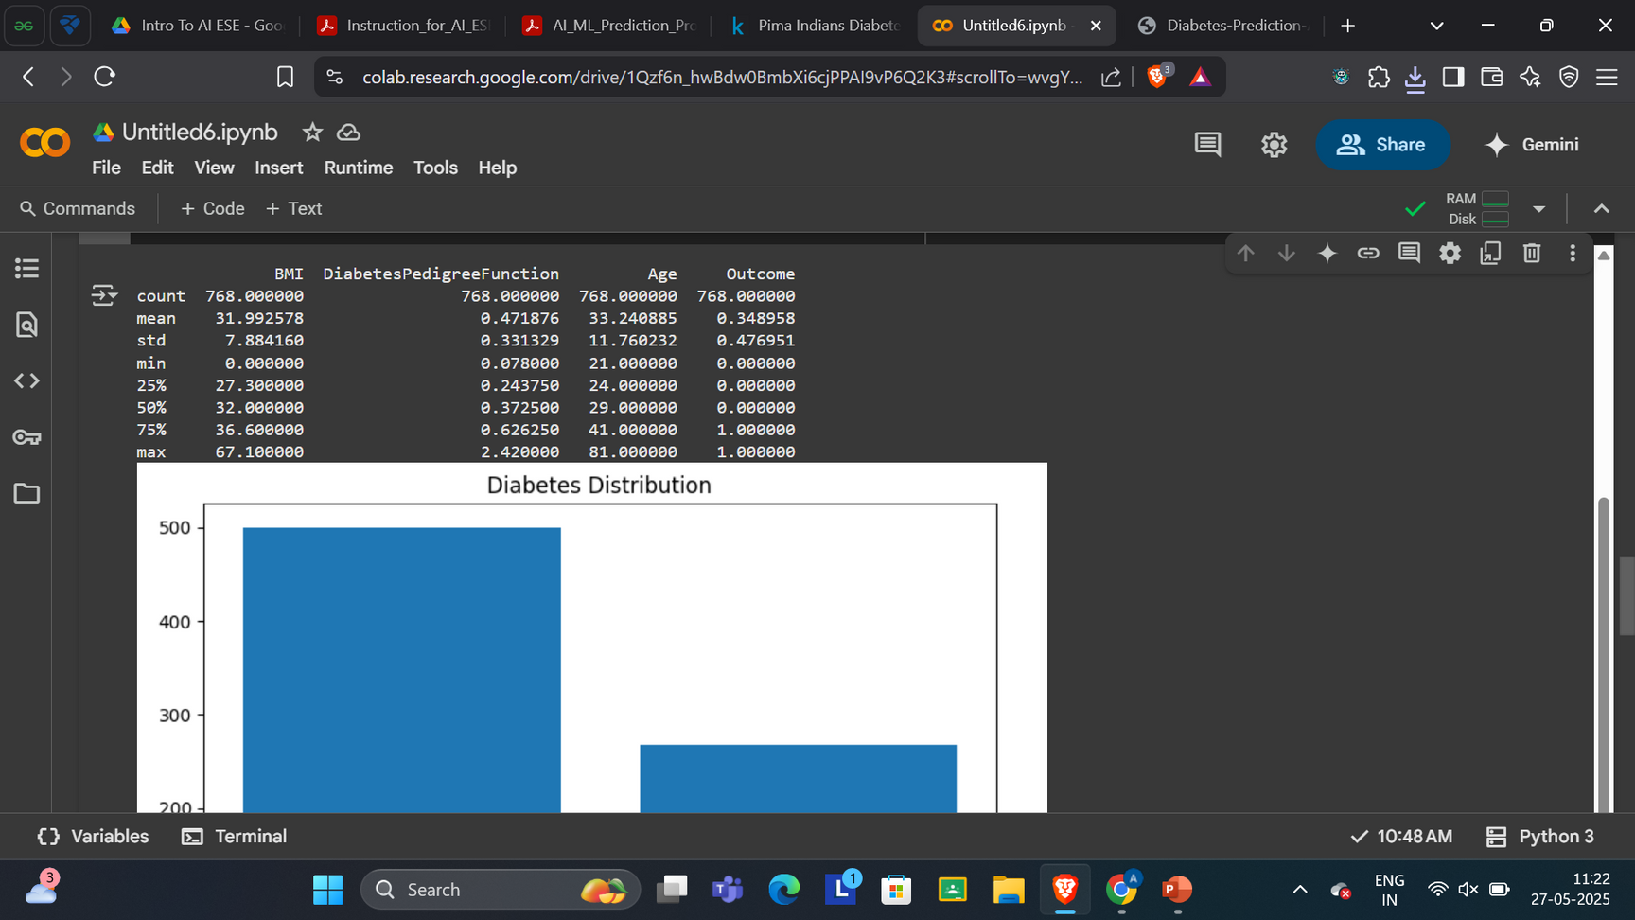
OUTPUT
7

Slide 8
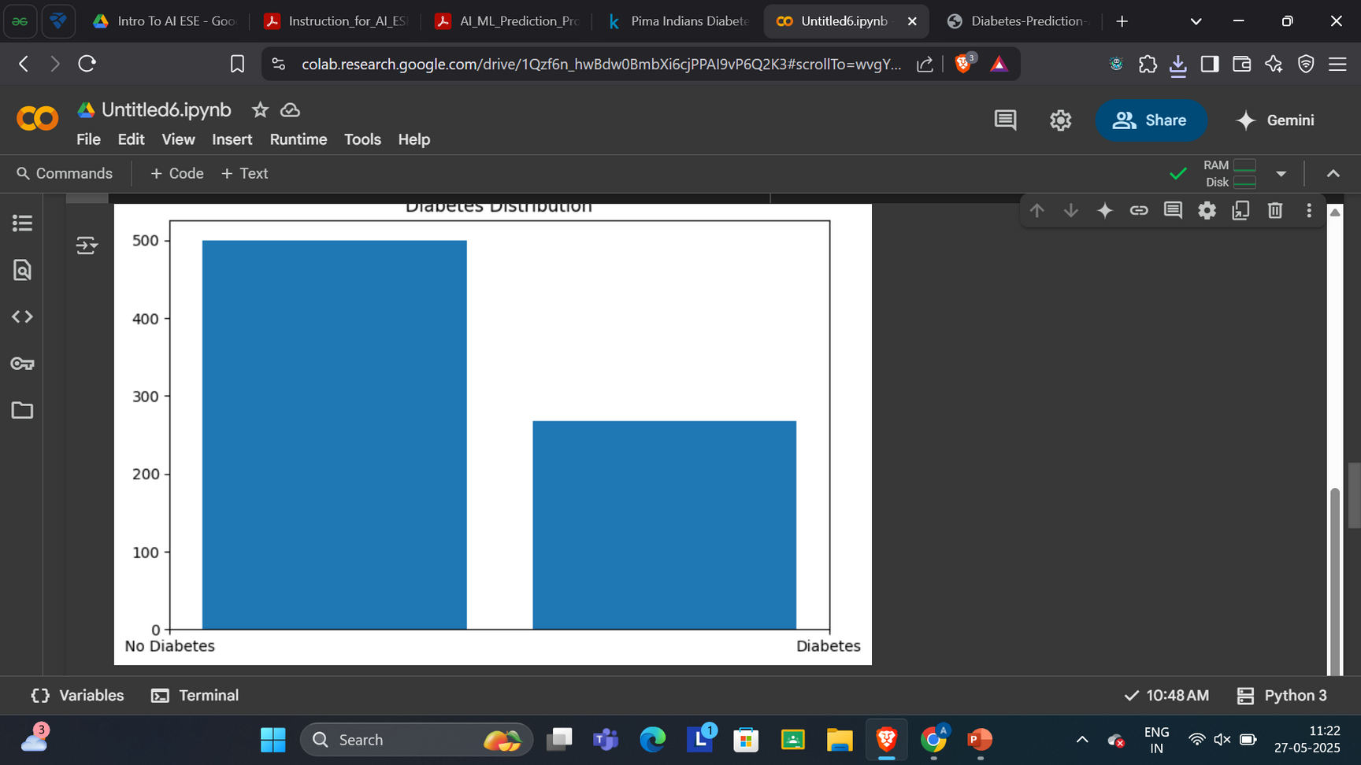
OUTPUT
8

Slide 9
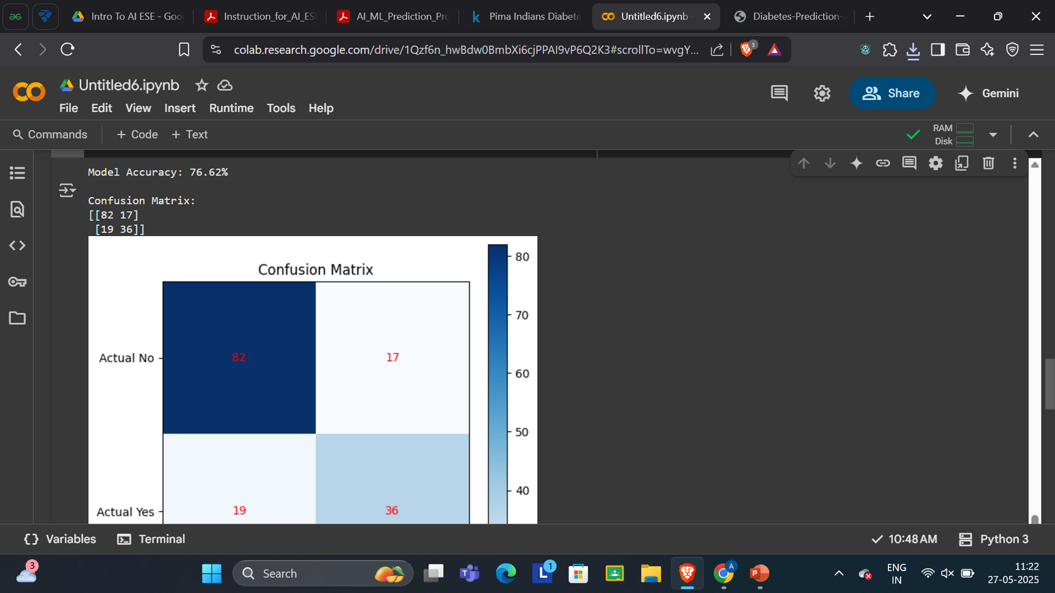
OUTPUT
9

Slide 10
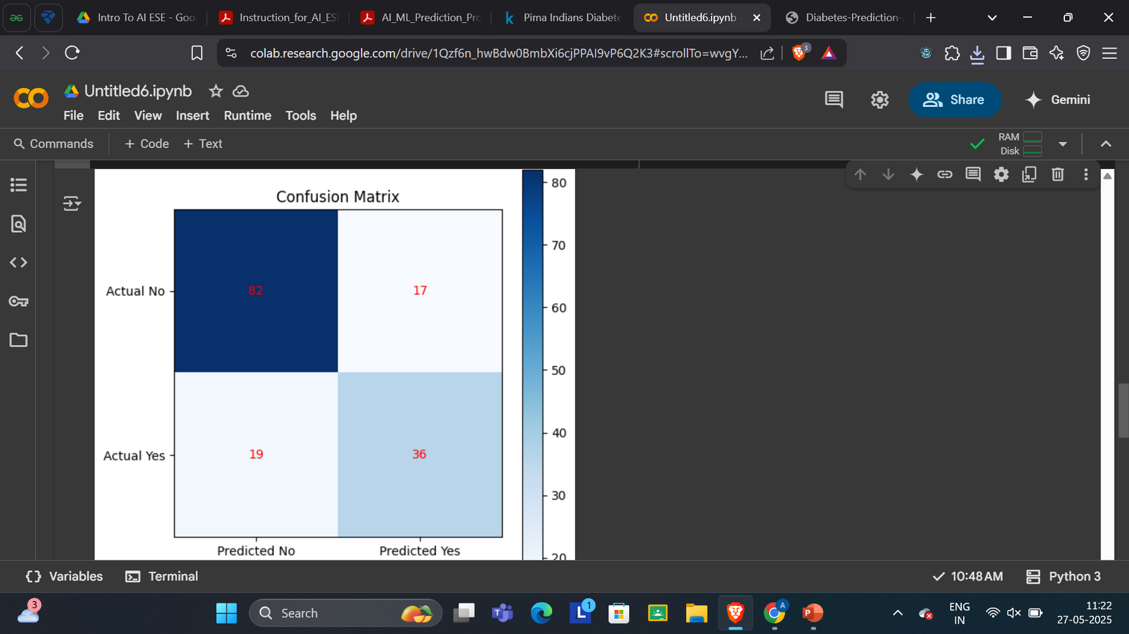
OUTPUT
10

Slide 11
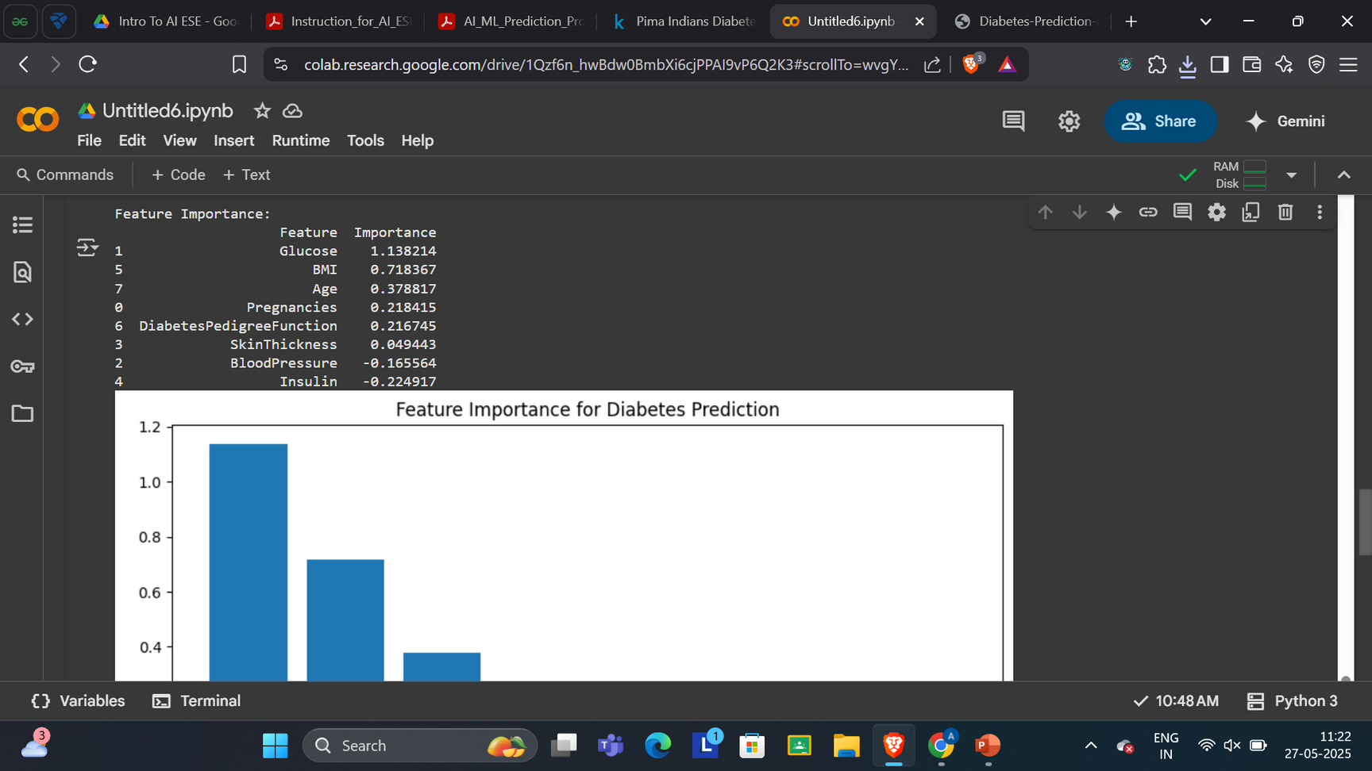
OUTPUT
11

Slide 12
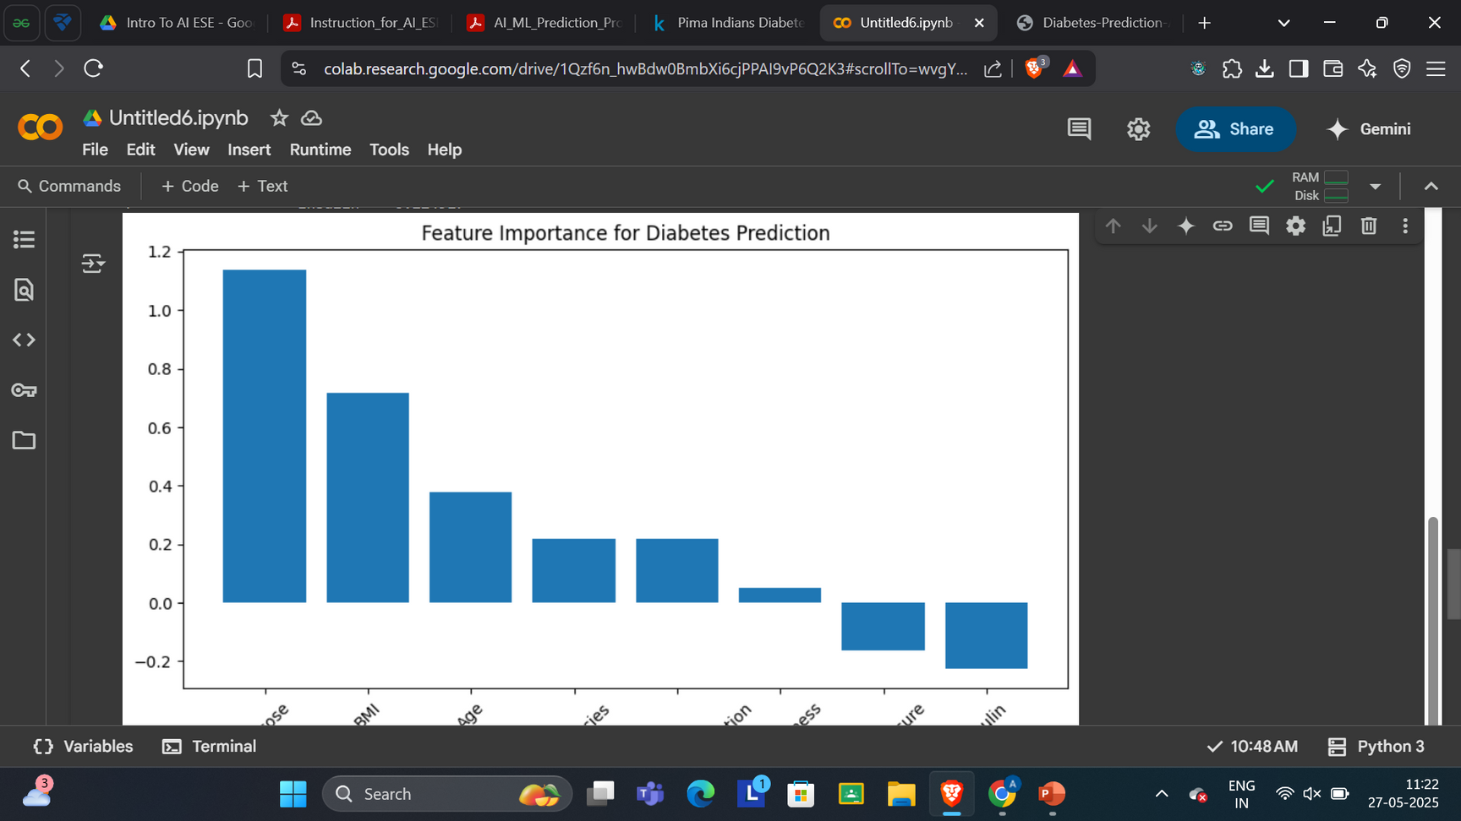
OUTPUT
12

Slide 13
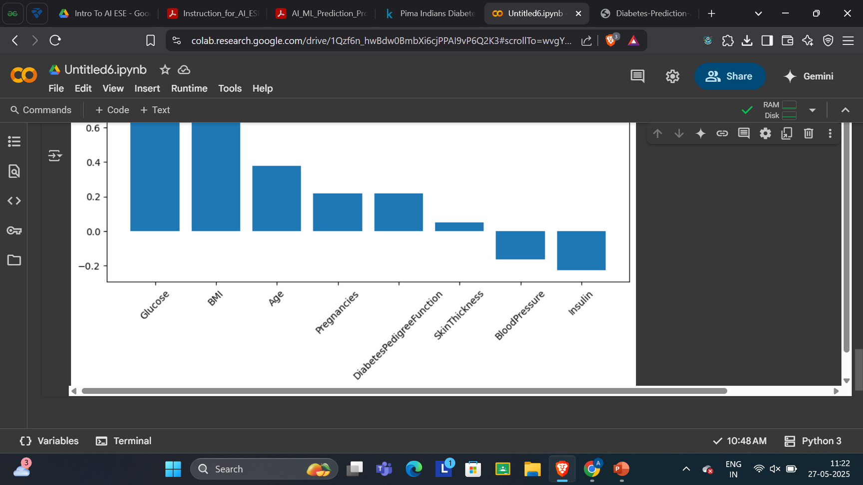
OUTPUT
13

Slide 14

REFRENCES
- Dataset: Pima Indians Diabetes Dataset - https://www.kaggle.com/datasets/uciml/pima-indians-diabetes-database

